Slide 1
Introduction
Nimish Narang

Slide 2
Learning Goals
Basics of programming in Python
Explore the primary components of Python
Store and modify data
Execute behaviours and implement logic

Slide 3
What do you Need Going in?
No experience necessary!
We will explore the language and general coding concepts from a beginner’s perspective

Slide 4
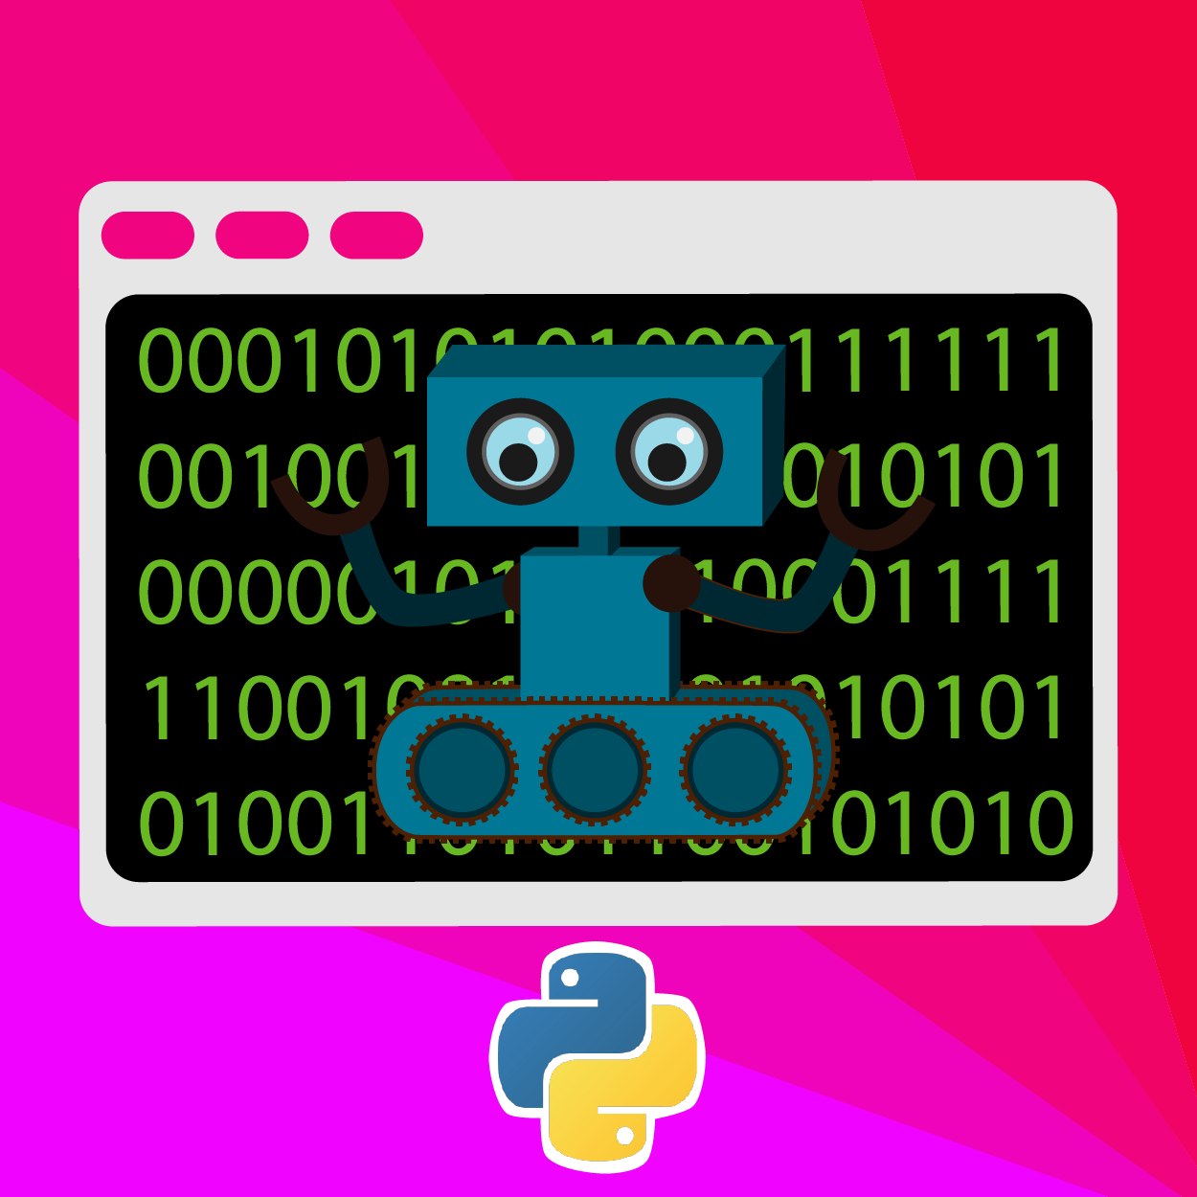
What Topics will we Cover?
Introduction to Python
Introduction to REPL
Variables
Operations
Collections
Control flow
Functions
Object oriented concepts

Slide 5
Intro to Python

Slide 6
Topics
What is Python?
What are some features of Python?
Why learn Python?

Slide 7

What is Python?
Python is a popular programming language
It’s used in many areas of programming including:
Data science
Machine learning
Desktop applications
Web servers
Game development

Slide 8
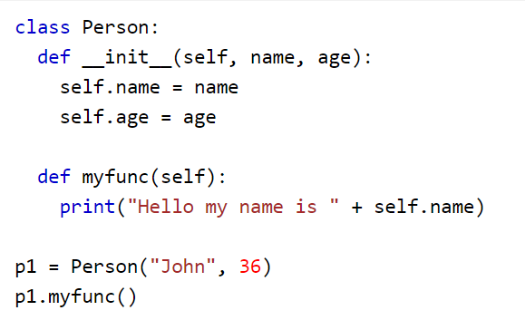
Features of Python
Dynamically typed
Minimalist syntax
Object orientated aspects

Slide 9
Why Learn Python?
Very popular (top 10 most used languages)
Wide variety of applications
Dynamically typed
Beginner-friendly syntax

Slide 10
Intro to Repl.it

Slide 11
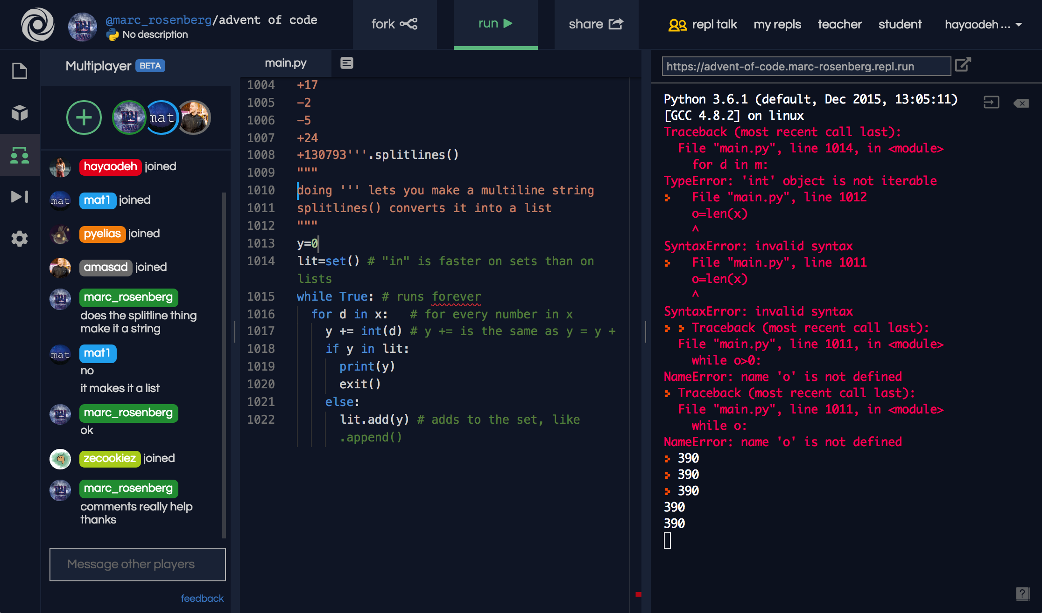
Topics
What is Repl.it?
Exploring the interface
Running a program

Slide 12
What is Repl.it?
Repl.it is an online environment where you can write and run code
Recognizes over 45 languages
Allows users to save and share code

Slide 13
Variables

Slide 14
Topics
What are variables?
Explore some examples in Python

Slide 15
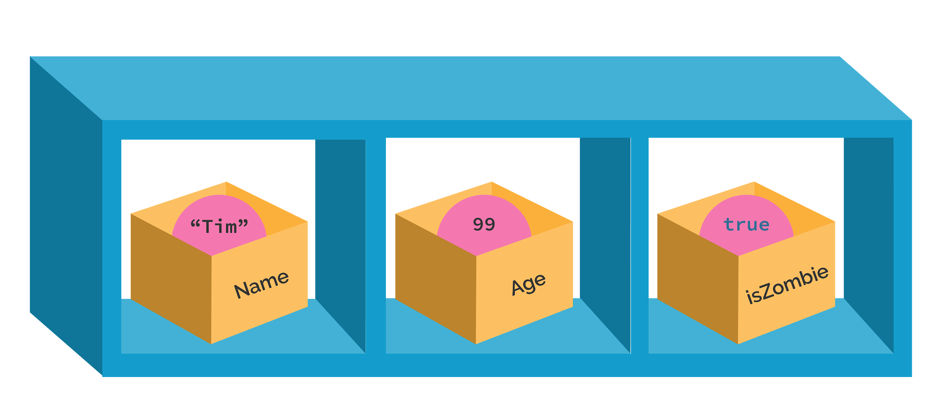
What are Variables?
A variable is how we store data in code
We can assign and re-assign values to it
We can contain different kinds of data such as numbers, text, etc.

Slide 16
Operators

Slide 17
Topics
What are operators?
Explore some examples in Python

Slide 18
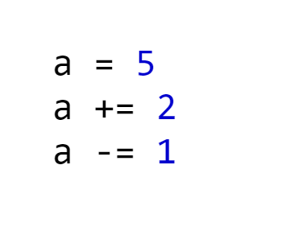
What are Operators?
Operators are symbols which perform specific mathematical, relational or logical operations.
They can be used for:
Addition
Subtraction
Multiplication
Division
etc...

Slide 19
Collections

Slide 20
Topics
What are collections?
Explore some examples in Python

Slide 21
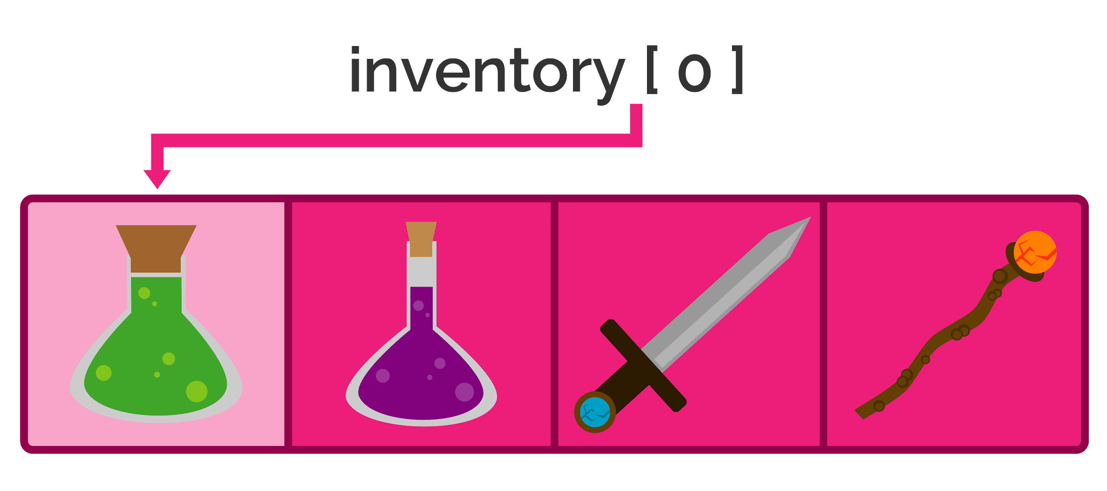
What are Collections?
Way to store multiple values in one variable
Access and modify individual values based on position in the list or key

Slide 22
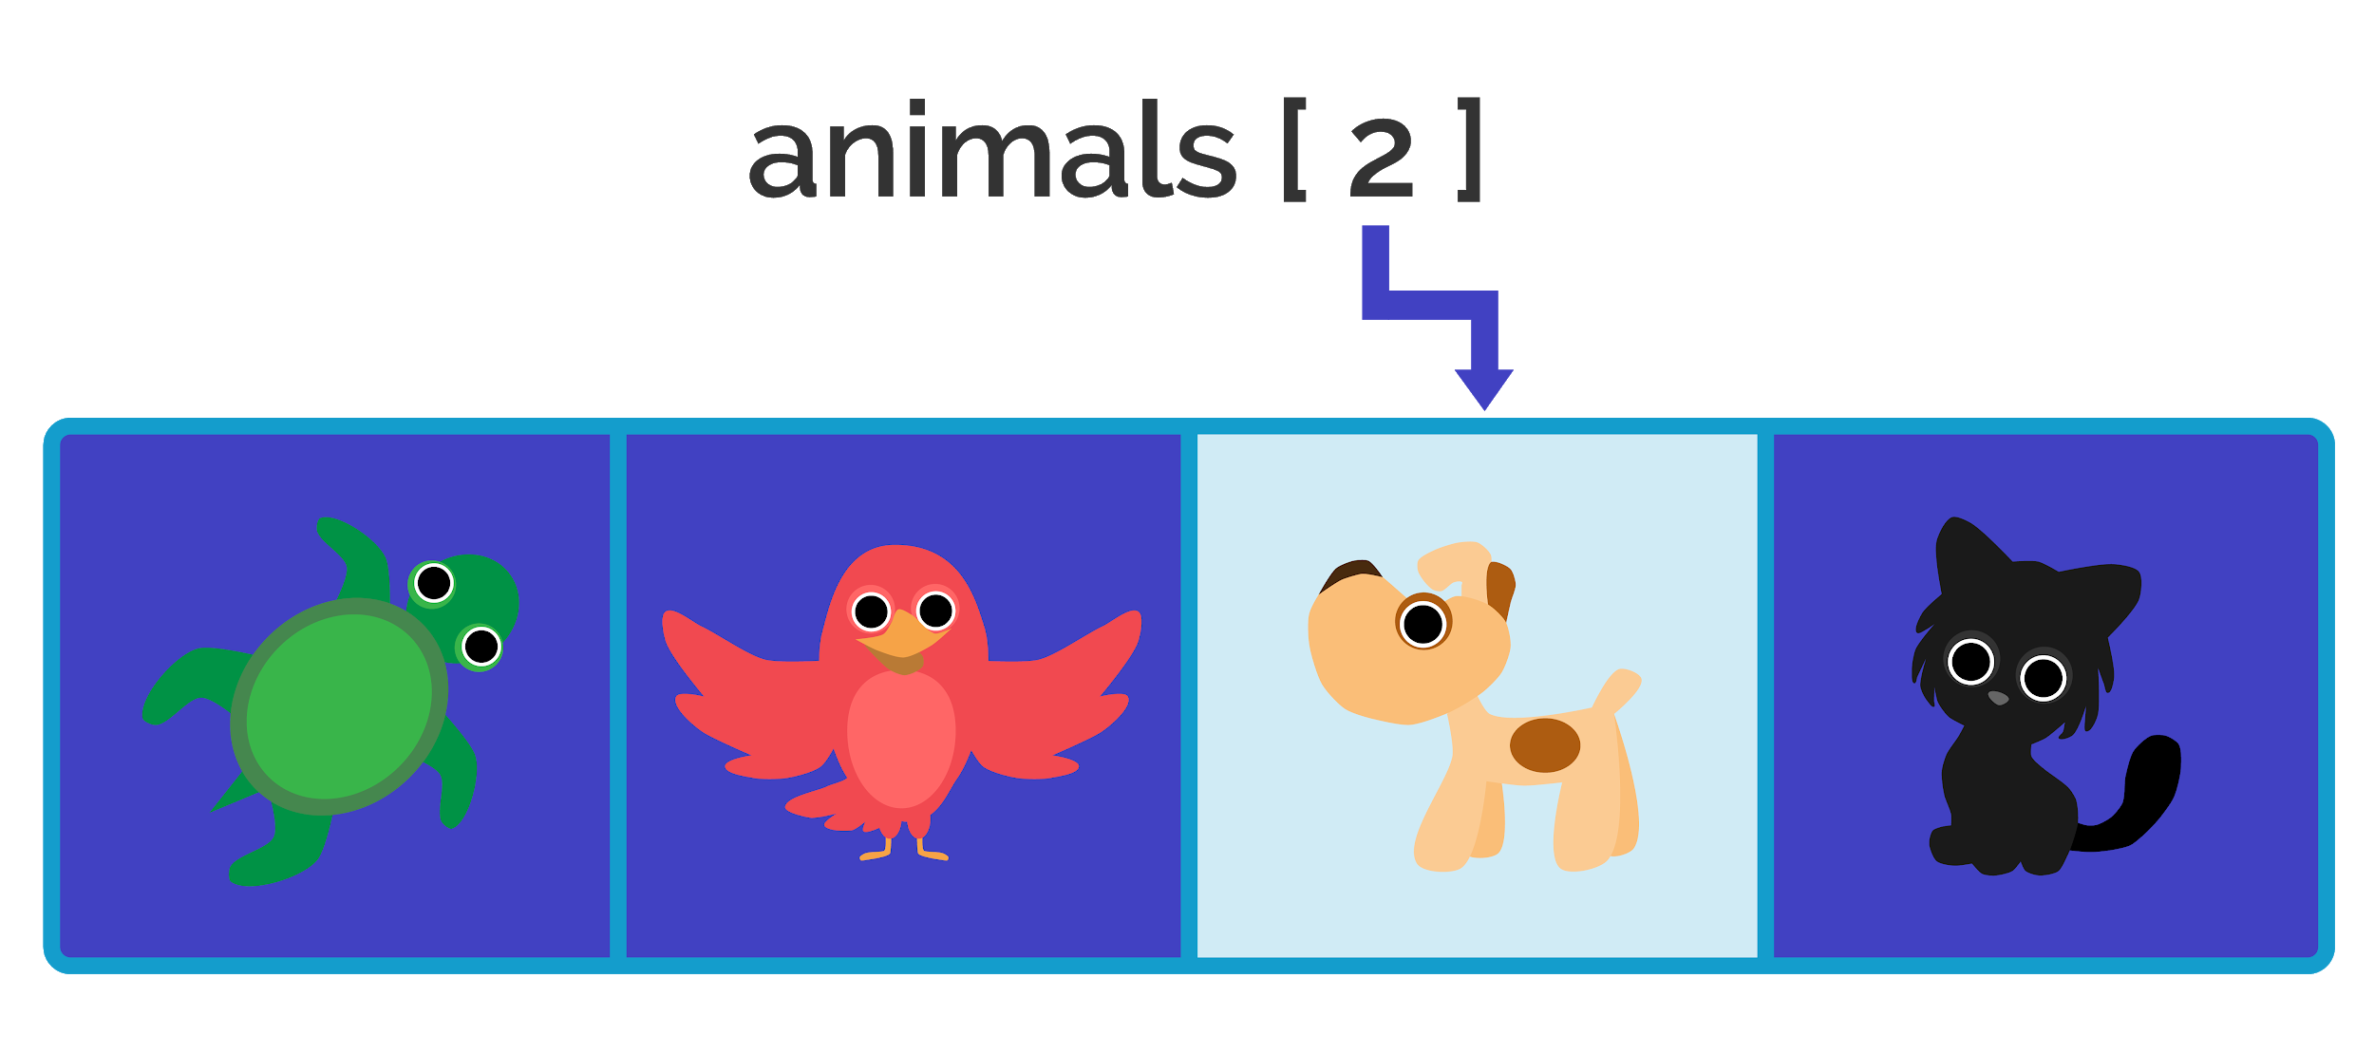
What are Collections?
3 types in Python:
Lists store values based on position
Tuples are like lists but cannot be modified
Dictionaries store values at keys rather than positions

Slide 23
Control Flow

Slide 24
Topics
What is control flow?
Explore some examples in Python

Slide 25
What is Control Flow?
Control flow is checking a condition and executing code if that condition is true
A condition for example could be:
Is one number equal to another?
Is this number greater than that one?
Does a list contain a specific value?

Slide 26
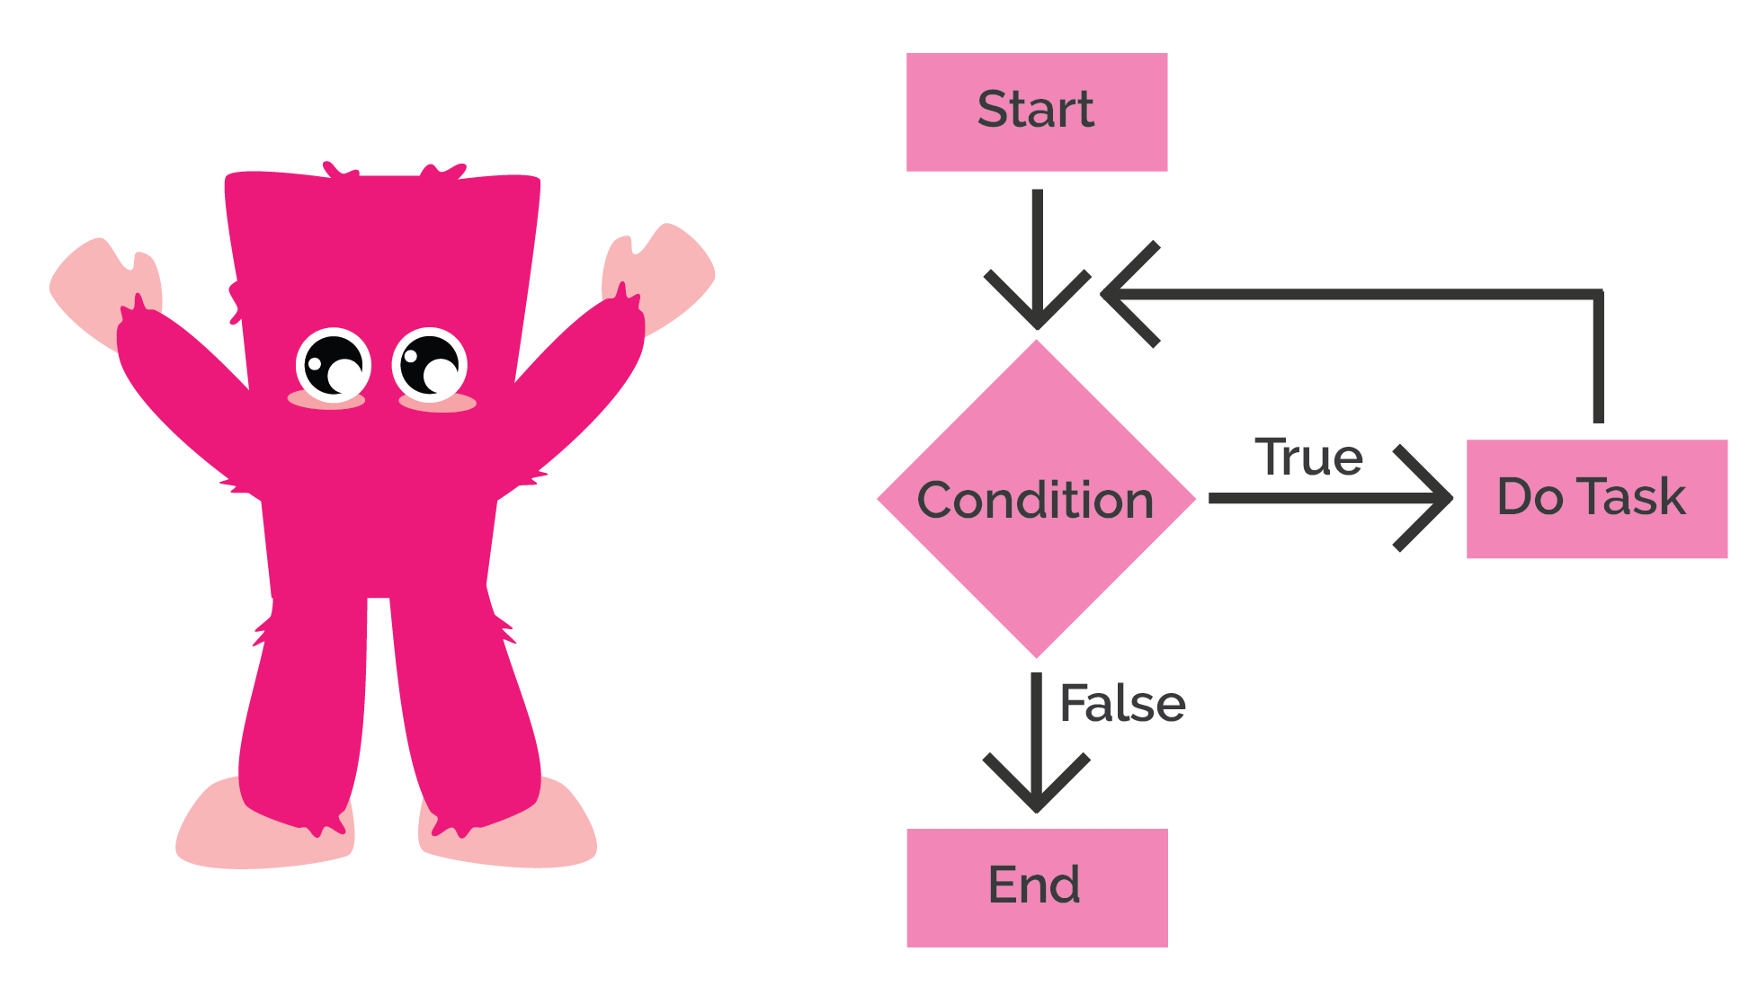
What is Control Flow?
We will explore:
If statements
While loops
For in loops

Slide 27
Functions

Slide 28
Topics
What are functions?
We’ll explore some examples in Python

Slide 29
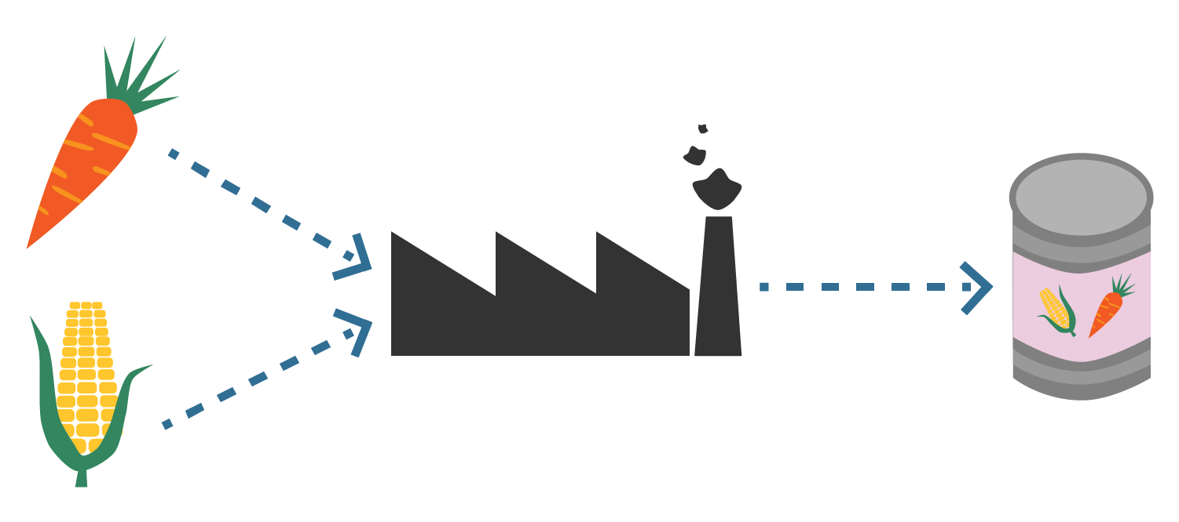
What are Functions?
Functions allow you to create repeatable blocks of code
Provide a way to choose exactly when and where to execute some code
You can input values and receive an output as a result

Slide 30
Objects and Classes

Slide 31
Topics
What are objects and classes?
We’ll explore some examples in Python

Slide 32
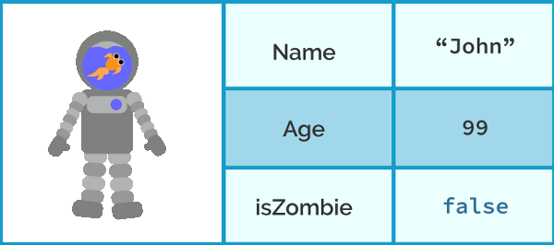
What are Objects and Classes?
Objects are entities in code with related variables and functions
A Player object would have:
Variables for health, damage, move speed, etc
Functions for movement, attacking, etc.

Slide 33
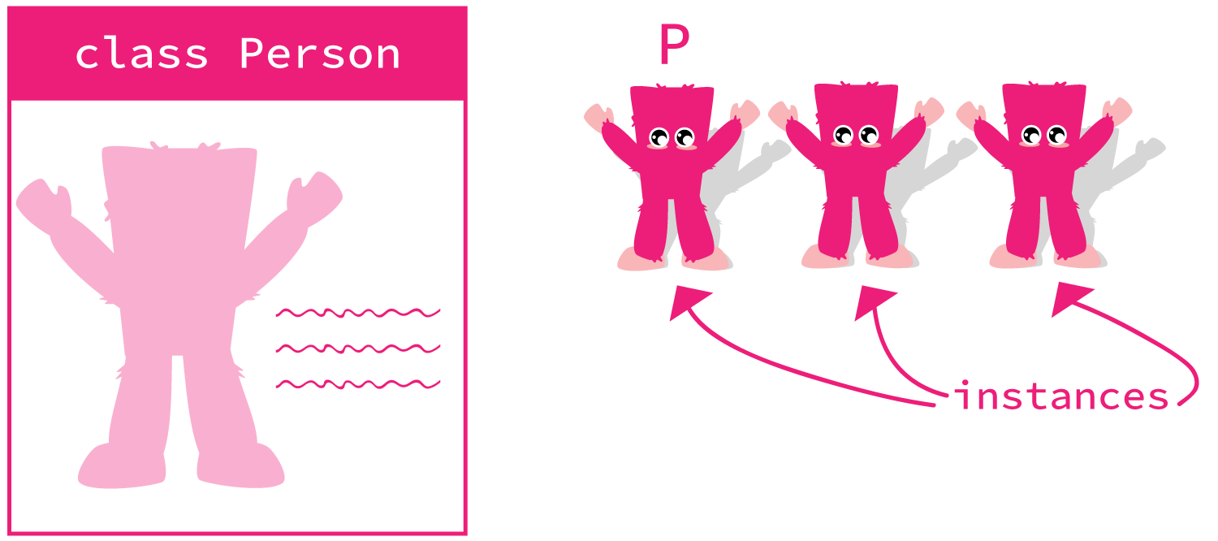
What are Objects and Classes?
Classes act as blueprints for objects - defining the variables and functions.

Slide 34
Summary

Slide 35
Learning Goals
Basics of programming in Python
Explore the primary components of Python
Store and modify data
Execute behaviours and implement logic

Slide 36
What Topics did we Cover?
Introduction to Python
Introduction to REPL
Variables
Operations
Collections
Control flow
Functions
Object oriented concepts

Slide 37
Where to go from here
Practice the language basics
Explore other components of Python
Start practical projects

